Slide 1
Carbon nanotube and its application in FET
By
Subhayu Choudhury
Assistant Professor
Santipur College

Slide 2
What is Nanomaterials?
1 nm= 10⁻⁹m
Nanomaterials describe, in principle, materials of which a single unit is sized (in at least one dimension) between 1 and 100 nm (the usual definition of nanoscale).
One billion nanometers equals one meter.
The average width of a human hair is on the order of 1000000 nanometer.
A single particle of smoke is in the order of 1000 nanometer.

Slide 3
Why nanomaterials?
Nanotechnology exploits the benefits of ultra small size, enabling the use of particle to deliver a range of important benefits
Small particles are invisible.
The behavior of nanoparticles depend more on surface area than the composition itself.
Relative surface area is one of the principal factors that enhance its reactivity, strength and electrical properties.

Slide 4
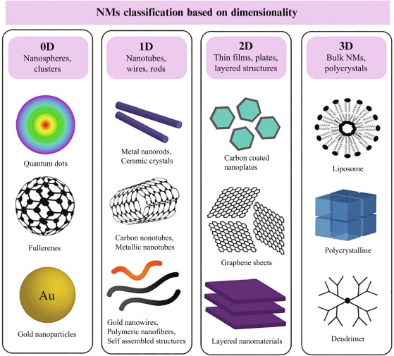
Different Types of Nanomaterials

Slide 5
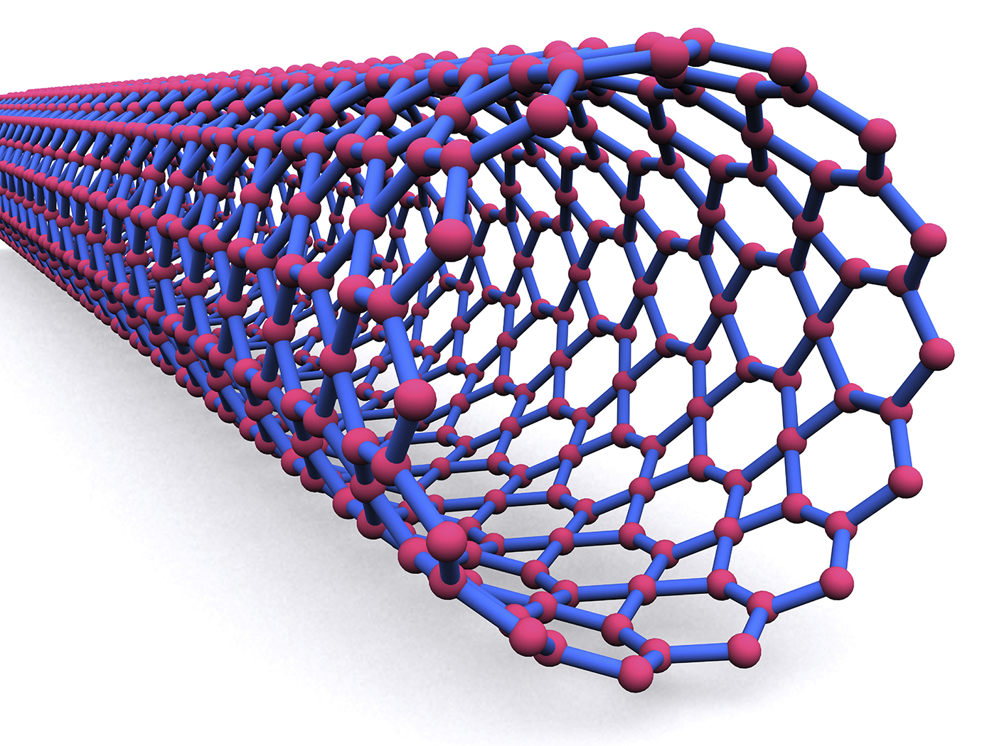
Carbon Nanotube
Carbon nanotubes can be considered as cylinders made of graphite sheets, mostly closed at the ends, with carbon atoms on the apexes of the hexagons, just like on a graphite sheet.
This 1-D form of carbon was accidentally observed in 1991 by S. Iijima under a transmission electron microscope.
He observed during examining some sample of carbon clusters viz. ‘fullerens’ synthesized using electric arc discharge method.

Slide 7
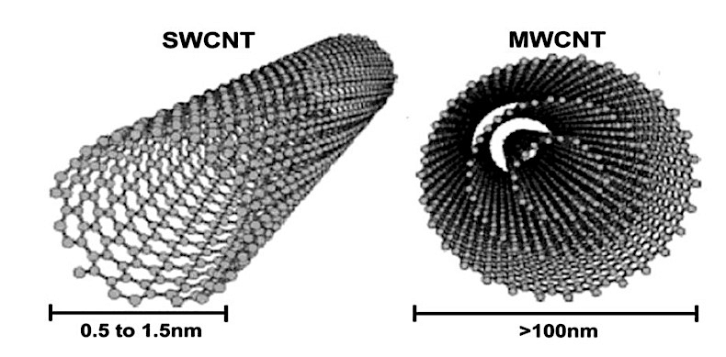
Different types of CNT
Two types of CNT has been observed.
One is Single Wall Carbon nanotube(SWCNT) and Multi Wall Carbon nanotube(MWCNT).

Slide 8
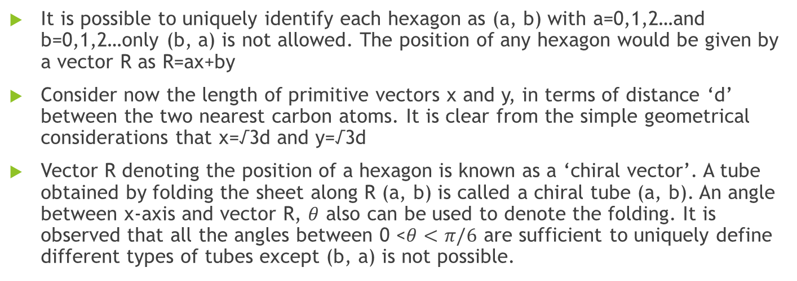
Chirality:
It is possible to uniquely identify each hexagon as (a, b) with a=0,1,2…and b=0,1,2…only (b, a) is not allowed. The position of any hexagon would be given by a vector R as R=ax+by
Consider now the length of primitive vectors x and y, in terms of distance ‘d’ between the two nearest carbon atoms. It is clear from the simple geometrical considerations that x=√3d and y=√3d
Vector R denoting the position of a hexagon is known as a ‘chiral vector’. A tube obtained by folding the sheet along R (a, b) is called a chiral tube (a, b). An angle between x-axis and vector R, $θ$ also can be used to denote the folding. It is observed that all the angles between 0 <$θ<π/6$ are sufficient to uniquely define different types of tubes except (b, a) is not possible.

Slide 9
Types of SWCNTs
Depending upon their chirality or the way of folding basically three types of SWCNT arise viz. zigzag, armchair and helical CNT.
Zigzag CNT: These are formed for angle 0 and chirality (a, 0). i.e. by folding parallel to x-axis. The name zigzag has been given due to zig zag arrangement of carbon atoms that can be seen if cross section of the tube as shown in the figure is taken. This type of tubes are ‘achiral’ tubes i.e. their mirror images are similar as the original structure.

Slide 10
Armchair CNT: These are formed for the angle ∏ /6 and chirality (a, a). These also are ‘achiral in nature’. Armchair structure with arrangement of carbon atoms can be seen in Fig.
Helical CNT: These are obtained when angle is anywhere between 0 and ∏/6 and chirality is (a, b). Helical structure of CNT is shown in Fig

Slide 11
Properties of CNT:
Highly electrical conductivity
Highly thermal conductivity
High chemical stability
High thermal stability
High surface area
High strength and hardness etc.

Slide 12
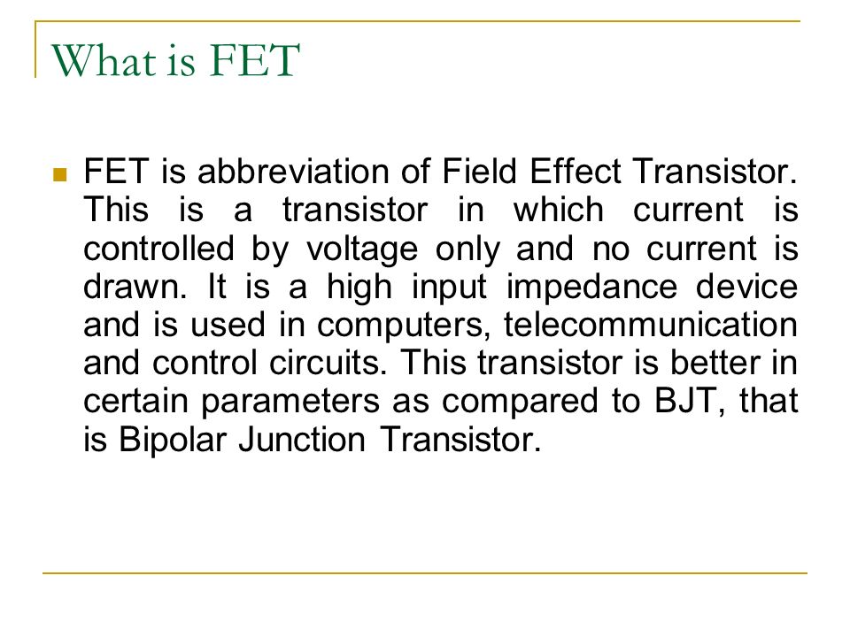
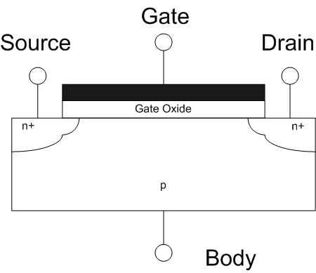
What is FET?

Slide 13
Limitations of FET scaling.
Short Channel Effect:
Tunnelling Limit:
Threshold Voltage Effect:
Oxide Thickness:

Slide 14
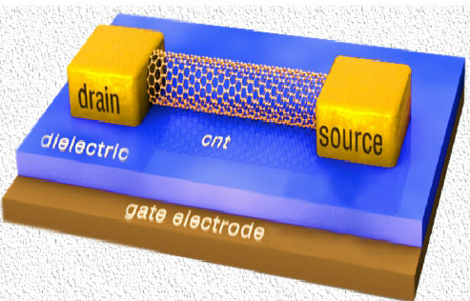
Carbon nanotube Field effect transistor.
The first carbon nanotube field-effect transistors were reported in 1998. These were simple devices fabricated by depositing single-wall CNTs (synthesized by laser ablation) from solution onto oxidized Si wafers which had been pre-patterned with gold or platinum electrodes. The electrodes served as the source and drain, connected via the nanotube channel, and the doped Si substrate served as the gate.

Slide 15
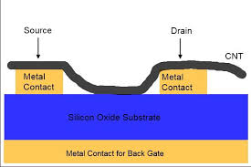
Different types of CNT-FET
Back-gated CNFET:Majority of the early CNTFET devices were back-gated with very thick gate insulators made of silicon oxide approximately around 10o-150nm . This structure used a non-local back-gate with the carbon nanotube side is bonded to noble metal electrodes . Noble metal is a type of metal that resists the attack of acids and other reagents and does not corrode. Fig.shows the structure of back gated CNTFET.

Slide 16
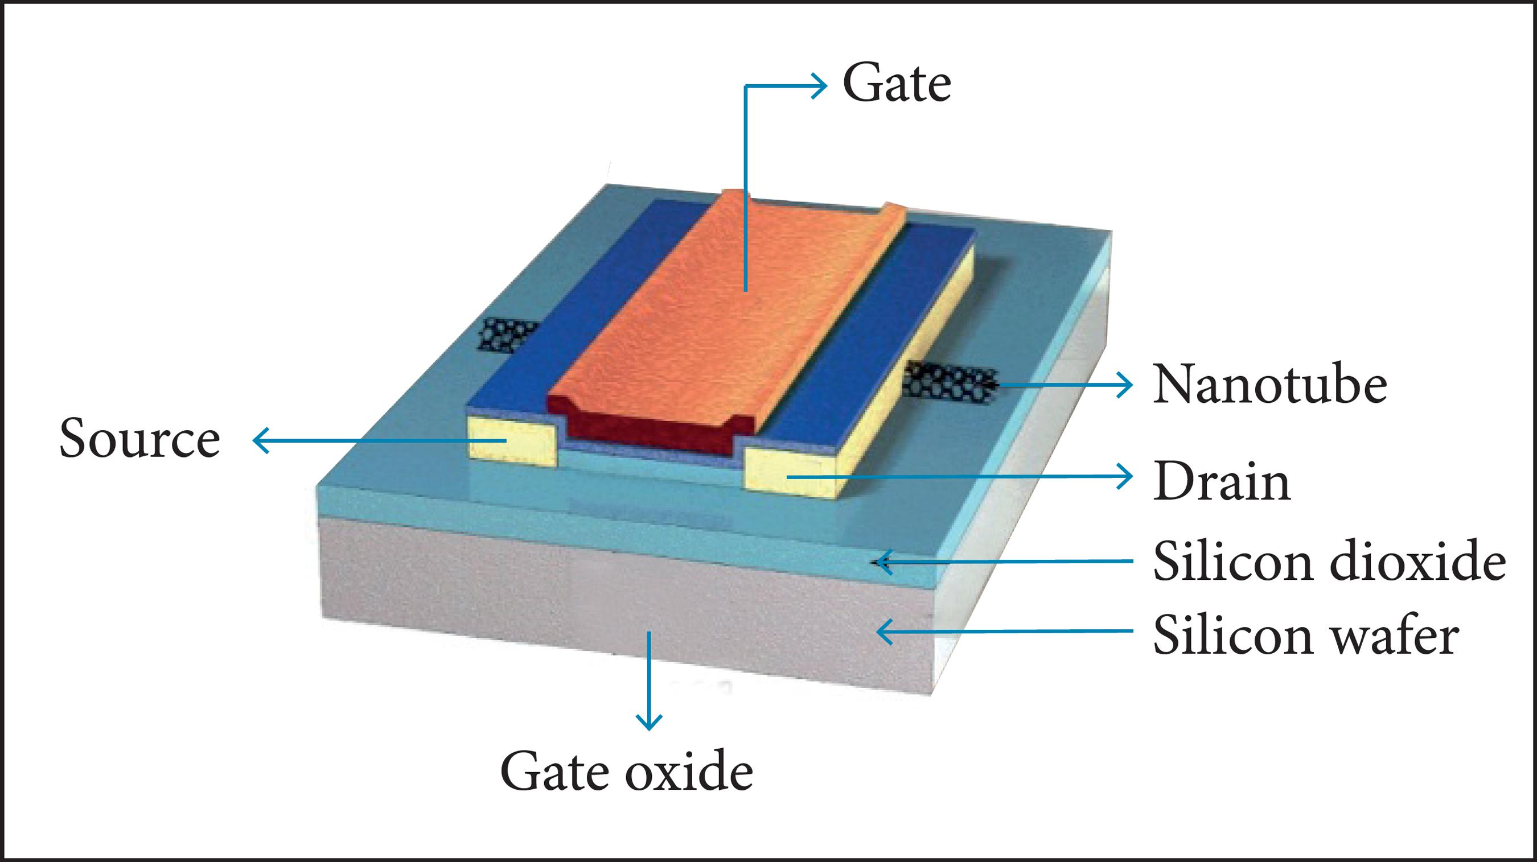
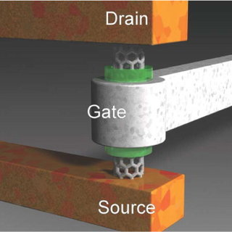
Top-gated CNTFET: The next generation of CNFET came in top-gated structure to improve the device performance. Since the performance in back-gated structure is rated quite poor in terms of the device operation, thus this new structure is expected to bring better result. This structure is fabricated by dispersing the carbon nanotube on an oxidised wafer.
Vertical CNTFET: The latest development in CNFET progress could be the initiation of vertical CNFET. This structure with surround-gated is suggested by Choi et. al. in 2004.

Slide 17
References:
M P Anantram and FL "Leonard. " Physics of carbon nanotube electronic devices " Institute of Physics Publishing, Rep. Prog. Phys 69 (2006) 507 561
. Rashmita Sahoo et al..”Carbon nanotube Field Effect transistor: Basic Characterization and Effect of High Dielectric material” International journal of Recent trends in Engineering, Vol2 No7 November 2009
P Avouris . J Appenzeller. R. Martel , and S .J Wind. "Carbon nanotube electronics ", proceedings of the IEEE Vol. 91. pp. 1772 1784, 2003.
S.A.Khan,M.Hassan…. A thesis on “Characterization of Carbon Nanotube Field Effect Transistor”
P.L MeEuen, M. S. Fuhrer. and H . K. Park. "Single-walled carbon nanotube electronics ", IEEE Transactions on Nanotechnologv, Vol. I. pp. 78-85, 2002

Slide 18
Thank You

